Slide 1
Automobile
Company
Database Design Phase 3
Prototype

Slide 2
Table of Contents
01
02
03
04
Updated Entity Relationship Diagram
Updated Schema Diagram
Website Presentation
Presentation of the Login/Signup, Guest and User/Customer View
Website Presentation
Presentation of the Admin View

Slide 3
01
Updated ER & Schema Diagram
Presentation of the Improved Entity Relationship Diagram & Schema Diagram

Slide 4
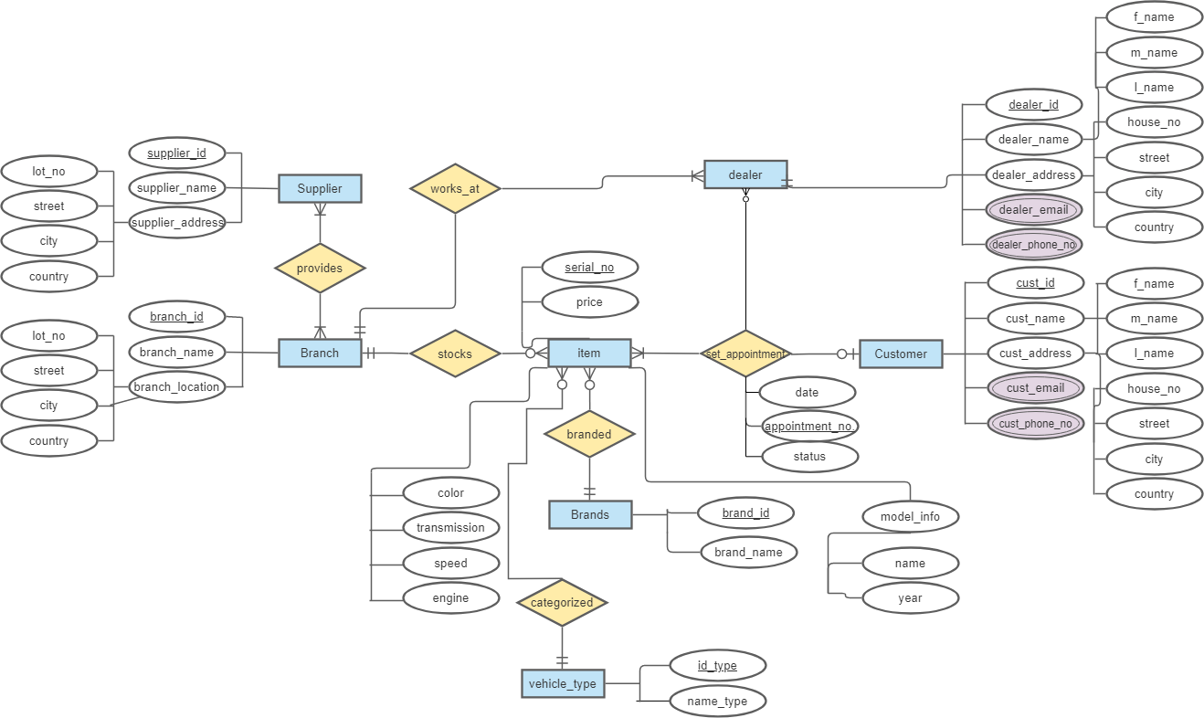
ER DIAGRAM

Slide 5
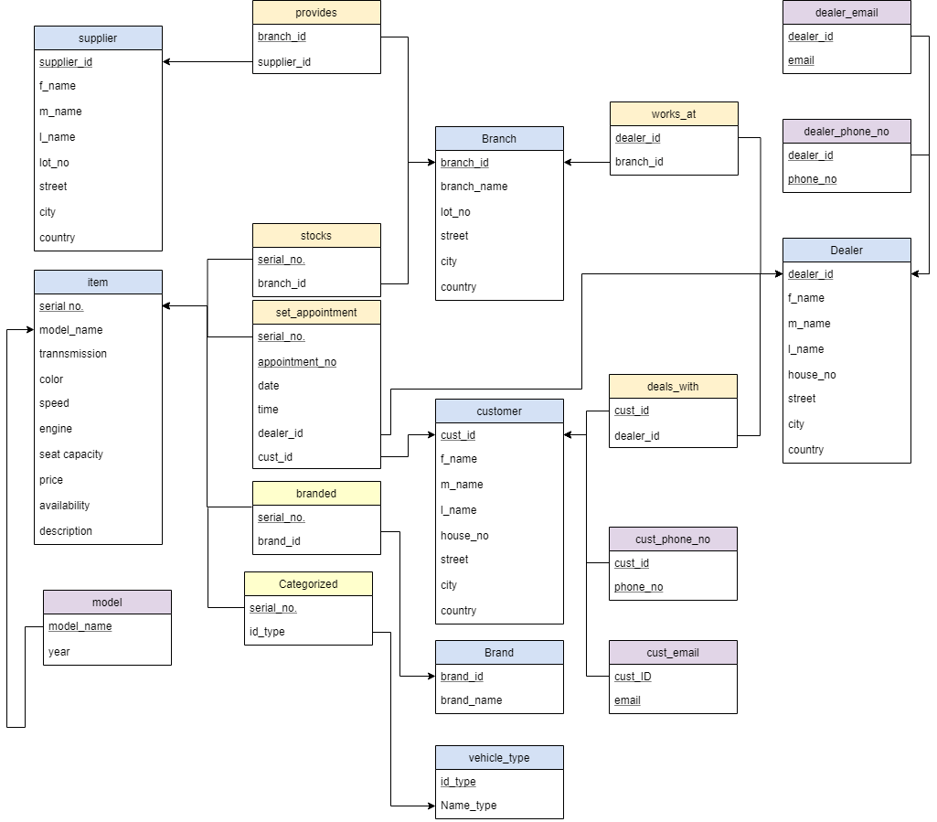
SCHEMA DIAGRAM

Slide 6
02
Website Presentation
Presentation of the Login/Signup, Guest and User/Customer View

Slide 7
03
Website Presentation
Presentation of the Admin View

Slide 8
Thanks!
Do you have any questions?
Presented by:
Alondra Andal
Shaina Bess Medina
Elizabeth Chua
Please keep this slide for attribution

Slide 9


